Slide 1
Summer Project 2021
(May - July)
Chatbot Generator for Visitors at a University and proving their effectiveness

Slide 2
Speaker: Ridam Hazra (CSE, Sophomore, NIT Durgapur)
Senior Mentor: Tarmo Koppel (UoSC)
Faculty Mentors: Sandeep Kumar (IIT-R), Biplav Srivastava (UoSC)
Interests: Machine Learning, Deep Learning, Data Visualization, Front End Development
Background:
Decision-support for the Masses by Enabling Conversations with Open Data
Configuration on user’s preferences
Usage of AI/NLP tools for automating chatbot generation
A/B testing on chatbots via randomized controlled trial

Slide 3
Problem:
The incoming students have standard questions that usually cover the same set of topics. Answering questions takes much time for the support staff and the answers may be delayed for many days.
Approach & Solution:
Design: A chatbot generator that will generate a chatbot for a university
Reponses Dataset: Predefined set of responses in English for testing and training
Training: Neural Network for predicting the best response from the dataset for the user’s utterance
Testing: Its effectiveness with students using it and without it, also the aim is to measure the effectiveness of chatbot with respect to real people
Validation: The chatbot based AI will be validated by conducting a randomized controlled trial, which includes analyzing the records of chatbot dialogue
Code available at: https://github.com/rhazra-003/Chatbot_USC

Slide 4
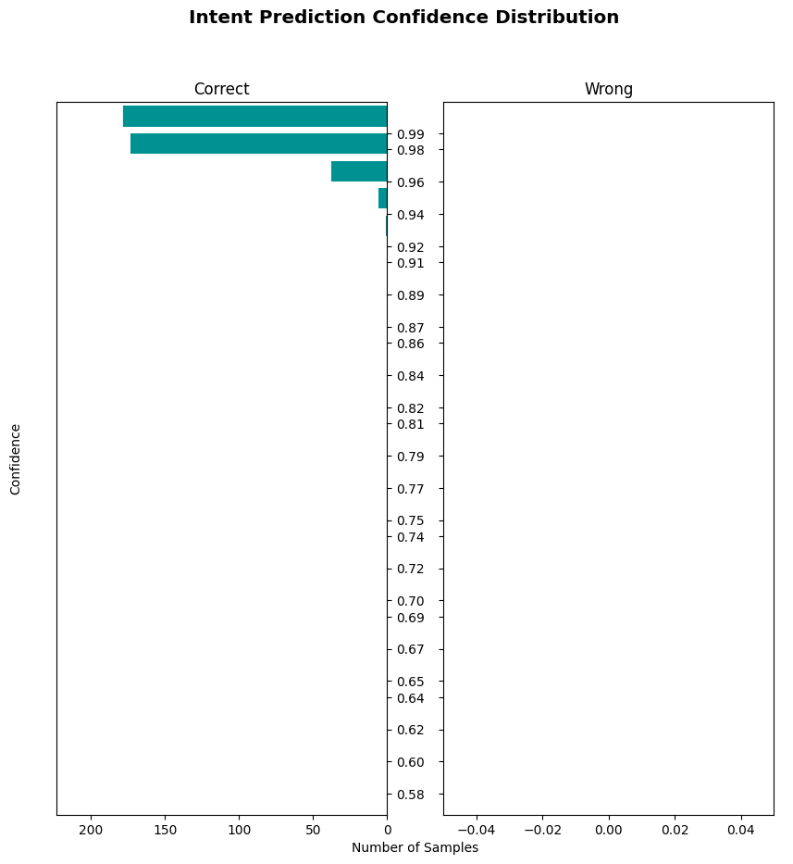
Evaluation:
Created dataset of Q&A for 3 Unis (UoSC, IIT-R, NIT-D)
Explored Rasa framework
Achieved the creation of chatbot with f1 score of 0.9983 with about 50 intents
Recording of the conversation for user preference analysis
Problem with deployment for technical issues in Rasa
Work in progress for design of randomised controlled trial

Slide 5
Works to be done:
Trying out the autogenerativenss (for 2 or 3 university variants)
Creating and carrying out the whole testing procedure starting from UoSC
Analysis of the conversations with users
Taking the system to production level
Publishing paper in AI/NLP related conference

Slide 6
Thank You!!

